Slide 1
Fraudulent Students in Higher Education
2026

Slide 2
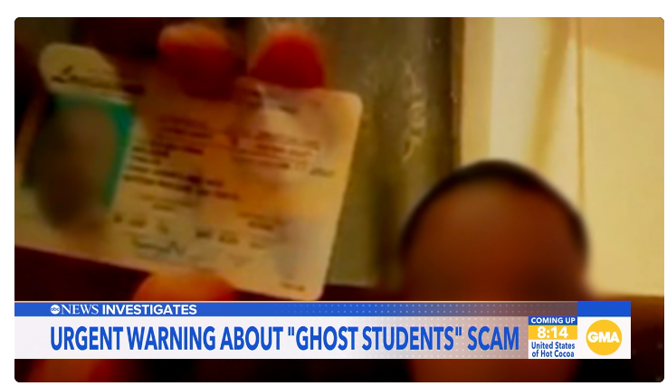
Nation-wide Problem
https://abcnews.com/US/inside-ghost-student-scam-identity-theft-steal-college/story?id=129359506

Slide 3
Committees
Small Group (Meets bi-weekly)
  Featuring leadership from the Registrar, Admission, Financial Aid, and Bursar offices
Large Group (Quarterly)
  Small group + leadership from IT, lead academic advisors, and our online learning team
State-wide (Complete)
  Kevin Wesselman & Audrey Woods

Slide 4
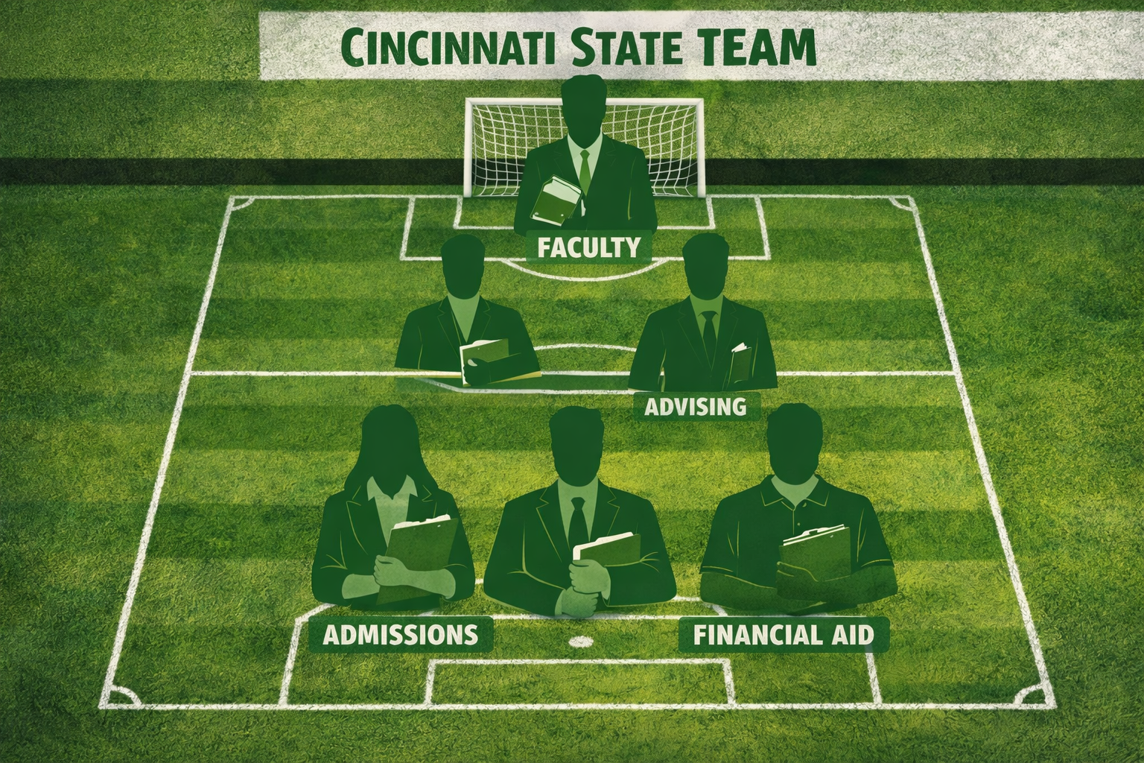
Fraud Squad
Notes:
For Fall 2025 and Spring 2026 Applicants, admissions stopped 436 people from being admitted which is about 3.5% of all Main application applicants for FA25 andSP26

Slide 5

Admissions

Slide 6
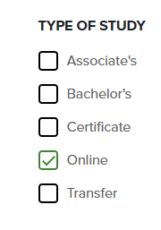
How do they do it?
Emailing fake transcripts
Stealing identities to get social security numbers and order official transcripts
  3rd parties not taking responsibility.
Applying from out-of-state for online programs.

Slide 7

Element 451 Fraud Detection
Timing indicators
Duplicate Applications
Email Address Analysis
IP Address Analysis
Location Analysis
Phone Number Analysis
https://help.element451.io/en/articles/9927313-bolt-app-fraud-detector-agent
Notes:
1. Timing Indicators: Time to submit & Local submission
2. Duplicate Applications: Duplicate users & Multiple applications
3.Email address Analysis: Validity scores, Disposable emails, Bounces and Blocked access
4. IP Address Analysis: Multiple IPs used or applicants using the same IP. VPN detection. Location Consistency
5. Location Analysis – When there is a significant discrepancy between the IP address and the stated home address or institution.
6. Phone Number Analysis: Flags VoIP (internet-based) numbers, Reviews Carrier and Risk Assessment, Identity Match.

Slide 8
Current Review Process
Admission Review
Element 451 Fraud Detector
HIGH
Medum/Low
Application is stopped from hitting Colleague and “ID verification” automatically appears as a required checklist item.
Applications flow into Colleague as normal.
High
Medium
Low
Notes:
Earlier I mentioned that admissions stopped 436 people from being admitted. About half of them were stopped as High risk.

Slide 9
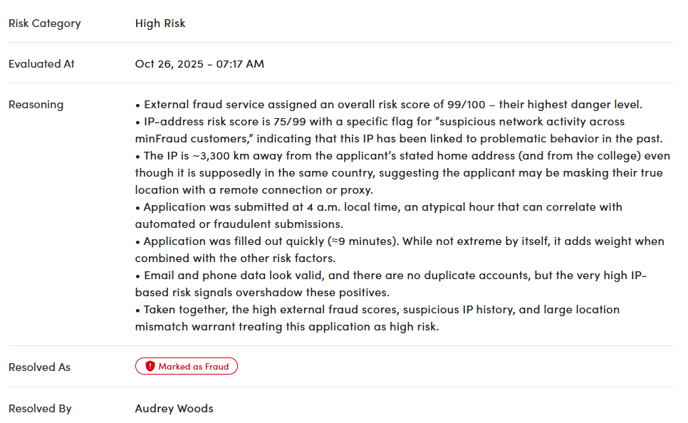
High Risk Example
Admission Review
Notes:
Each application must be reviewed closely because having 1 or 2 risk factors does not mean it's automatically fraud.

Slide 10
Review Process
Admission Review
Transcript arrives
HIGH
Medum/Low
Director Review
Records Team reviews its validity. If it appears fraudulent, the director is alerted, otherwise it is processed as normal.
Director reviews and either (a) adds an ID verification to the checklist (b) contacts the student with a clarifying question or (c) admits
If the student also came in with an ID, the application is assigned to the director for review.
Admissions records team will assign to director for review if they notice a red flag.

Slide 11
Red Flags
Out-of-state phone numbers with local addresses
Applying for entirely online programs.
Asking to change phone numbers or calling from different phone numbers.
Commonly outlook or icloud emails.
Demanding they be able to email ID.
High school out of tri-state
Submitting a BA transcript to have the local HS transcript waived.

Slide 12
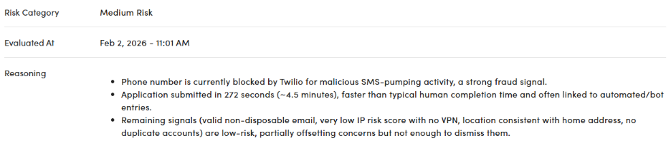
EXAMPLE
Phone number area code: 912 (Georgia)
High School location: Wisconsin
College Location: Florida
Home Address: PO Box
Email: icloud.com
I placed an ID Verification on it. They never showed or responded.

Slide 13
Stripe ID Verification
Started 6/1/26
Allows us to target certain populations of applicants for online ID verification. This cost $2 per verification
  Out of tristate area addresses
  Non-Reciprocity county KY and IN residents
  Students in online programs
  Students who Element's bot considers Medium Risk
  Students we manually assign

Slide 14
Stripe ID Verification
Started 6/1/26
The student experience https://help.element451.io/en/articles/13006508-identity-verification
Results: 1,557 students have completed the verification
  Verified 1,154
  Manual Verification 104
  Failed 54
  Started 243

Slide 15
Other Software Considered
Voyatek - Provides ID verification like Stripe Contact: Heather Hutchings heather.hutchings@voyatek.com
Sentinel 360 powered by National Student Clearinghouse – We have not investigated this yet, but several administrators are attending a webinar to learn more
Submittable – This was recommended to us by our rep at US Bank. We will be receiving a demo soon

Slide 16
Financial Aid

Slide 17
OVER 100 Million Dollars Annually
Fraud is all over the US and over 900,000 applications were flagged in California alone in a 3-year period.
Federal Student Aid announced they adjusted the FAFSA to try to prevent fraud.

Slide 18
What we look for and what we are doing?
  FEDERAL STUDENT AID INCREASED THE NUMBER OF FAFSAs SELECTED FOR V4/V5 (IDENTITY VERFICATION)
  Submit ID in person or through mail with notary signature
  Submit federal tax returns
  INCREASE IN STUDENTS SELECTED FOR INSTITUTIONAL VERIFICATION
  Student manually change IRS information on FAFSA
  Different addresses on FAFSA and application
  Non-filers, with dependents and no government assistance
  Students not living in Ohio, Kentucky, or Indiana

Slide 19
As of August 1, 2026
  Cincinnati State has returned over $355,000 in federal aid
  since August 2025 for 30 Students
  Example: Sally Surge
25/SU
ACC-101
MGT-101
MGT-105
MKT-101
Received
Pell - $2835
Subsidized - $3313
Unsubsidized - $1708
Refund - $4853.78
25/FA
ECO-110
LAW-101
MAT-105
FYE-110
Received
Pell - $3698
Subsidized - $1732
Unsubsidized - $2969
Refund - $5354.01
26/SP
ACC-102
HST-111
SOC-105
MGT-125
No Aid given
Total Returned: $16,255

Slide 20
Registrar/Bursar

Slide 21
Banking Information
Account Validation Services (AVS).
  Weekly file of student (refunds), employee (for reimbursements, not payroll) , and vendor (invoice payments) banking information is sent to US Bank for validation.
  The system is not perfect (ie, not all banks participate, names mismatch can occur whereby a student has access to a bank account but is not listed as the owner, some internet banks validate on only ABA routing # and account #, not owner of account).
  The Accounting Office rejects any “Denied” results and emails student/employee/vendor to provide replacement banking information and information in Colleague is de-activated.

Slide 22
Banking Information
If a student reports that a scheduled electronic refund did not settle with the receiving bank, the Bursar researches the banking reports for a bounce back and responds accordingly:
  Bounce back? Void transaction, reissue refund to replacement bank or issue paper check
  No Bounce back? Provide student with Trace ID (ACH Origination Code) for follow up with their bank. Student may then file a police report if issue is not settled satisfactorily with their bank.

Slide 23
Reports
  IT has created a report for Bursar’s use titled XAR02 – Duplicate Banking Info. This report displays any student/employee/vendor who shares banking information with another student/employee/vendor.

Slide 24
Registrar
  Contact:
  Enough information is presented by the fraud team to question the admitted or enrolled student's identity.
  Email is sent to all addresses listed in Colleague.
    Sent from Registrar@cincinnatistate.edu
    Often the personal email addresses bounce back as invalid.

Slide 25
Ex: First Email
  Hi [First Name],
  It has come to my attention that there are discrepancies with your [Semester] enrollment at Cincinnati State Technical and Community College.
  Please come in-person to the Office of the Registrar with a valid state ID or driver's license.
  This must be completed by [Date] or your [Semester] classes will be dropped.
  Thank you,

Slide 26
Ex: Second/Final Email
  [First Name],
  You have not complied with the request below.
  Your [Semester] classes have been dropped and your academic program closed.
  Ann M Latham, MA
  Registrar
  (she/her/hers)

Slide 27
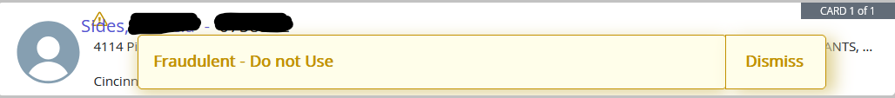
Registrar
Updating the record:
Record designated as "Fraudulent – Do not Use"
*former students

Slide 28
Advising

Slide 29
Red Flags to watch for
These indicators don’t prove fraud on their own, but taken together they should raise suspicion:
Unusual Behavior
  Reads answers from a phone or paper when asked basic personal questions.
  Unfamiliar with the program they are admitted to.
  Requests to change the phone number for an advising call.
  Struggles to spell or recall their own address, SSN, or date of birth.
  Discrepancy between application information and what they state in person.
  Uses a different name than the one on file and can’t explain why.
  Voice or accent sounds different from what your information suggests it should sound like.

Slide 30
Red Flags to watch for
These indicators don’t prove fraud on their own, but taken together they should raise suspicion:
Enrollment Red Flags
  Can only do all online classes.
  Wants to change major to a program with majority online classes.
  Attempts to rush through the process or asks repeatedly about financial aid disbursement/refunds.
  Will only do an advising meeting on the phone
  Asks to do advising via email
  Can’t log into their account without changing their phone number

Slide 31
What to do DURING the Meeting
If you suspect fraud while meeting with a student:
Stay Professional and Neutral
  Do not accuse them of fraud directly. Keep the meeting calm and routine.
Verify Gently
  Ask to confirm basic information (address, phone number, birthday)
  Use open-ended questions: “Tell me what interested you in this program.”
Delay Next Steps
  If something feels off, do not finalize registration or financial aid actions. Tell the student that “we need to verify a few things before proceeding.” OR “I’m sorry, something is up with my system right now. Let me investigate this and get back to you.”

Slide 32
What to do AFTER the Meeting
If you suspect fraud while meeting with a student:
Document Concerns: Immediately write a summary of what raised suspicion.
Report: Send your notes to the Audrey Woods, Director of Admissions.
Do Not lift the advising hold: Wait until the review is complete before advising further.
Document in Starfish: In your meeting notes write “Suspicious student, reported to committee. Do not set another meeting.”
Next Steps: Someone from the fraud committee will follow-up with next steps. Do not speak with the student again unless you are cleared to do so.

Slide 33
Classroom

Slide 34
What can faculty do?
  Now show period is our last chance to catch them!
  Can you strengthen your online class required participation?
  Can you use available tools to look for AI submissions?
  Can you request a meeting with students for whom you are suspicious?

Slide 35
Questions/ Comments?

