Slide 1

One Big Beautiful Bill
The Financial Aid Impact
Melanie Weaver
Keystone and PA Forward Student Loan Programs

Slide 2
OB3 Impacts to Financial Aid and Enrollment
1
Federal Loan Eligibility
4
Need Analysis Changes
2
Workforce Pell
5
Institutional Accountability
3
Federal Student Loan Repayment

Slide 3
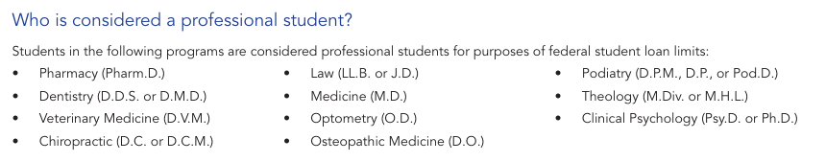
Federal Loan Eligibility – Graduate Students
Graduate student annual loan limit - $20,500
    Aggregate limit $100,000
  Professional student annual loan limit - $50,000
    Aggregate limit $200,000
New lifetime federal loan limit of $257,000
  Does include Grad PLUS! – Announced April 21, 2026
Grad PLUS Loan is eliminated

Slide 4
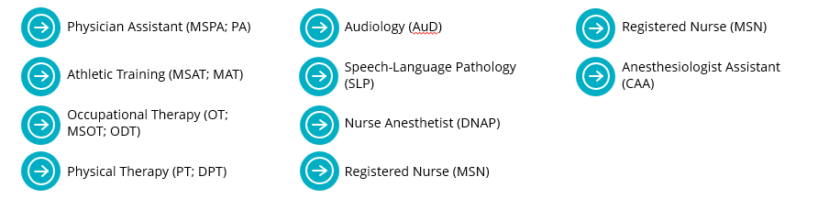
Updated - Federal Loan Eligibility – Graduate Students
A number of lawsuits have been filed regarding the professional student definition
  The definition has been temporarily expanded until the court stay ends
    Added programs of:
More programs are involved in other lawsuits and could be added at some point dependent on ruling

Slide 5
Limited Exception
Allows for some students to continue under the previous limits and loan eligibility
  Applies for both Grad PLUS and new loan limits
    Students cannot opt in or out of the exception
  Up to three academic years or the remainder of their expected time to credential, whichever is less
Student can lose this exception if they:
  Enroll beyond program length
  Withdraw and then re-enroll
  Transfer programs

Slide 6
Updated - Limited Exception
Webinar on August 12th by ED instructed schools to use credits instead of time for Expected Time to Credential
  Would significantly change eligibility for some students
  Many loans are already disbursed or in process
Waiting on clarification/official guidance from ED

Slide 7
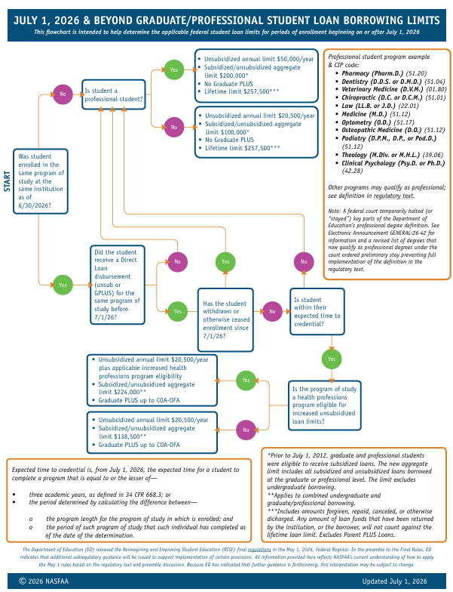
NASFAA Flowchart for Loan Limits

Slide 8
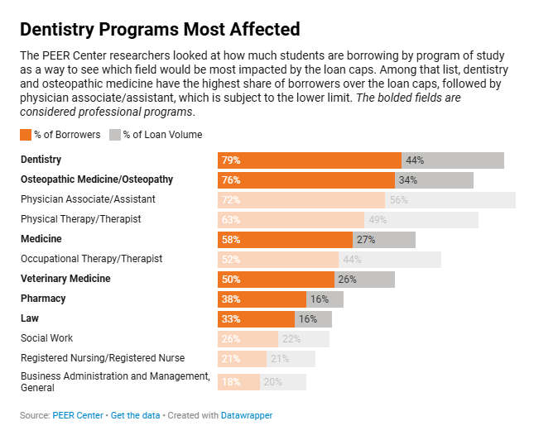
Impact
Loss of Grad PLUS will be impactful for many grad programs
Increased use of private loans to cover COA expenses after Direct Unsub
Limited and constantly changing definitions for “professional programs”
Leaves schools unsure of what limits to use for students in programs impacted by lawsuits.
Puts students at risk for having to return loan funds
Inclusion of Grad PLUS in lifetime limits will change what federal loans some students can borrow

Slide 9
Federal Loan Eligibility – Parent PLUS
New limit on Parent PLUS – annual and aggregate
  Maximum of $20,000 annually per year per dependent student
  Aggregate limit of $65,000 per dependent student
Same Limited Exception provision applies

Slide 10
Update and Impact – PLUS Changes
No major updates to this regulation
Parents of first-time borrowers for this year must consider how much is needed annually and in aggregate
Private loan market may be better option for some families
  Preferred Lender Lists will be important

Slide 11
Update and Impact – PLUS Changes
The aggregate amount of $65,000 does not allow a student to borrow the maximum each year for a standard 4-year program
  Concern about students starting with PLUS and then needing to switch to private
    Already borrowed PLUS debt will be factored into private loan approval and interest rate
College and University communication with parents about limits will be critical

Slide 12
Federal Loan Eligibility – Part-Time
New rules for prorating loan amounts for students enrolled less than full-time
  Schedule of Reductions (SOR)
Previously
  Students registered half-time or more, and were not graduating in less than an academic year, could have full annual limits
  If only attending a portion of academic year then graduating, a calculation was completed of # hours enrolled divided by 24
    Referred to as Historic Loan Proration (HLP)

Slide 13
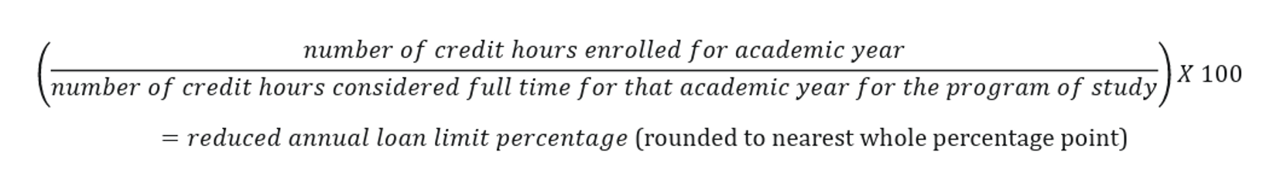
Federal Loan Eligibility – Part-Time
New Rules
Loans for students enrolled less than full-time for the academic year must be recalculated
Mandatory terms are included in denominator. Total hours enrolled in numerator

Slide 14
Update and Impact - Loan Eligibility – Part-Time
There are no Limited Exceptions for this provision. Applies to ALL students immediately
For schools with many student enrolled part-time this has added considerable work to aid packaging
Limits how much loan eligibility a student has annually

Slide 15
Update and Impact - Loan Eligibility – Part-Time
ED released FAQ guidance about SOR on August 7, 2026
  Clarified that SOR does not need to be performed for students with Historic Loan Proration
    Prevents a double proration
  Offers additional guidance on subscription based programs
  Addresses changes in COD
  Clarifies flexibility to not use substantially equal disbursements
  Provides guidance on addressing enrollment changes after a student’s loan is disbursed

Slide 16
Pell Changes
Workforce Pell
Expanded Pell grant to short-term, career-focused programs
Cannot be brand new program – must be approved by state governor
First workforce Pell program was approved in early August 2026
  Iowa Central Communicty College – Emergency Medical Technician program – 14 weeks
Reduced Pell Eligibility
Students must have a SAI of 14790 or less to qualify for Pell
  Began with 26-27 FAFSA
Foreign income now included in AGI to determine Pell
Students fully covered by non-federal grants and scholarships no longer qualify for Pell if COA is covered
  Schools can reduce non-federal aid to preserve Pell eligibility

Slide 17
Federal Loan Repayment
New plans apply to borrowers with new loans made on or after July 1, 2026
 | Current/Old Rules | New OB3 Rules
Standard Repayment Plan | 10-year repayment term | 10, 15, 20 or 25 year repayment term based on total loan balance
Income-Driven Repayment Plan | Income-Contingent (ICR) Plan Income-Based Repayment (IBR) Plan Pay As You Earn (PAYE) Repayment Plan | Repayment Assistance Plan (RAP)
Current income-contingent repayment plans (ICR, PAYE, SAVE) – eliminated July 1, 2028

Slide 18
Tiered Standard Repayment Plan
The total time allowed for repayment will be determined by the total loan balance
Loan Balance | Term
$0 - $25,000 | 10 years
$25,000 - $50,000 | 15 years
$50,000 - $100,000 | 20 years
More than $100,000 | 25 years
Applies to student and parents who have a new loan made on or after July 1, 2026
This tiered plan will not count for PSLF
Student borrowers would need to enter RAP, parents borrowing after July 1, 2026 will no longer have a PSLF option.
Parents with prior loans wishing to stay in PSLF will want to consider other payment options.

Slide 19
Federal Loan Repayment
Allows borrowers to rehabilitate a defaulted loan twice now – instead of once as previously allowed
Economic hardship and unemployment deferments are sunsetting
  Applies to borrowers with loans made on July 1, 2027 or after
Changes to loan forbearance
  Now up to nine months in any two-year period
  Previous rules allowed up to 12 months at a time – cumulative limit three years

Slide 20
Institutional Accountability
Final rules announced on July 1, 2026
Merging all accountability frameworks (GE/FVT) into a new one called Student Tuition and Transparency System (STATS)
  STATS begins July 1, 2027 for most changes
    Optional early implementation starting July 1, 2026
      Early implementation is assumed if institution submits October 1, 2026 GE/FVT without the data that the new rules eliminate
  Keeps earnings metric but removes debt-to-earnings metric
  Applies to almost all programs

Slide 21
Institutional Accountability
New rules that connect a program’s eligibility for federal aid to the post-graduation earnings of students in that program
  Undergraduate Programs – Compares the median U.S. Census Bureau earnings of those with a high school diploma (ages 25-34) to the median earnings of Title IV recipients for undergraduate degree program 4 years post-completion.
  Graduate Programs – Comparison is to median U.S. Census Bureau earnings of those with a bachelor's degree with same timing as undergraduate

Slide 22
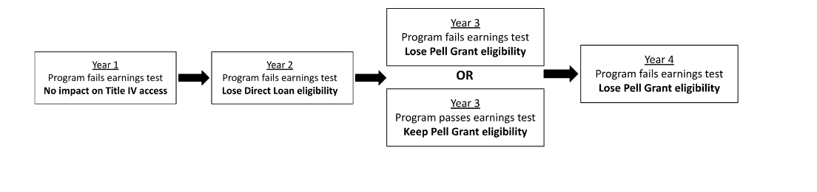
Institutional Accountability
Failing this test in any two of three consecutive years labels that program a “Low-Earning Outcome Program.”

Slide 23
Institutional Accountability Impacts
New standard – the 50% Institutional Trigger – if more than 50% of an institution’s federal aid dollars or 50% of aid recipients are associated with a failing program – institution is considered not administratively capable
  Would cause much stricter oversight
Teach-Out option
  School commits to program closure to allow current program students to retain federal loan eligibility
July 1, 2026
Optional early implementation of accountability framework
July 1, 2027
New framework in effect and ED publishes the first earnings premium results
July 1, 2028
The earliest a program could face penalties for Low-Earning Outcome

Slide 24
How is it Going?

Slide 25
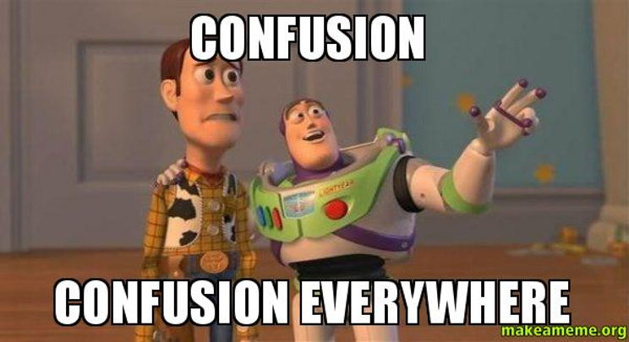

Slide 26
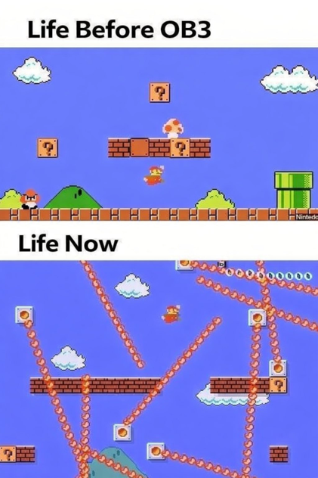

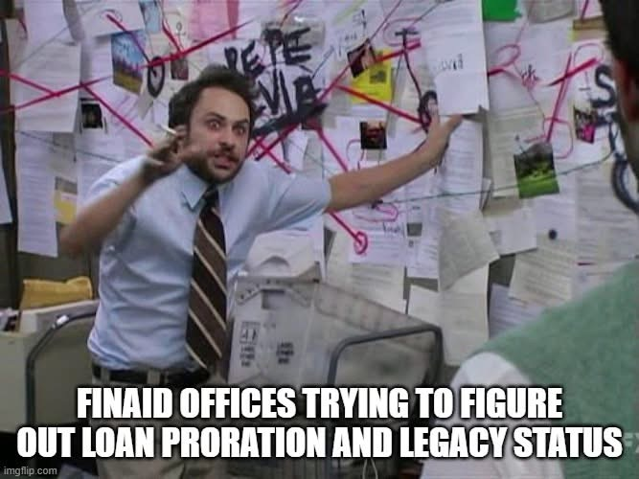

Slide 27
Compressed Timeline
November 1 Rule
  Regulations should be published in final form by November 1 in order to go into effect the following July 1
Timeline of Final Regulations for OB3
May 1, 2026
May 19, 2026
July 1, 2026
Final rules for RISE (Reimagining and Improving Student Education)
Federal Student Loan program regulations
Final rules for AHEAD (Accountability in Higher Education and Access Through Demand)
Workforce Pell regulations
Final rules for AHEAD
STATS regulations

Slide 28
Issues
No time to understand and ask questions
  Delay in final regulation release meant aid offices were understanding the new regulations at the same time as packaging for the 2026-27 year
  Especially challenging for summer header schools
SIS updates
  Compressed timeline meant most information systems were not ready to process with the new rules
  Updates are still rolling out this fall
Continued updates from ED with shifting guidance
  ED has held several webinars – many of which offered unclear or conflicting guidance
  Some questions have only been answered in an ED webinar and not published as official guidance
    Causes concern for how to proceed, audits, etc.

Slide 29
Issues
Very little time to communicate with students and families
  Many students qualified for different loan amounts than anticipated
COD processing issues
  Still rejecting valid loans
  Not reflecting legacy status
Many reprocessed ISIRs throughout the summer
  Created large volume of files for institutional review
Concerns about future audits with these shifting regulations

Slide 30
Thank You!

